Slide 1
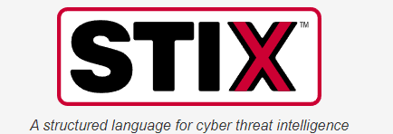

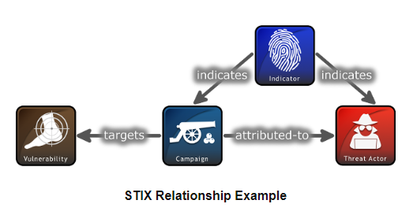
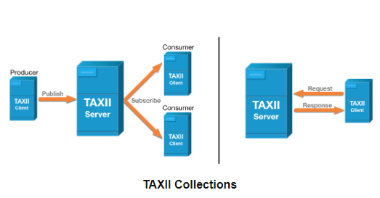
TAXII Proxy
Problem Statement
How does the Cyber Intelligence community improve the mechanisms used to share Cyber Threat Intelligence (CTI) at machine speeds

Slide 2
Issues With the Current Standard
No validation mechanism built into the STIX/TAXII Framework by default
Cyber Intelligence producers “enhance” the STIX standard with custom objects
Cyber intelligence consumer products sometime have undefined behavior for STIX objects that fall outside their expected interpretation of the standard.

Slide 3





Subscribed
unchanged
CTI Schema X
TAXII Proxy
TAXII Client
Consumer A
Publish
Subscribed
Subscribed
Subscribed
Publish
Verify
Publish
CTI Schema Y
TAXII client
Producer
TAXII Proxy
Subscribed
TAXII
SERVER
Subscribed
Converted
TAXII Proxy
TAXII Client
Consumer B
CTI Data
Schema Data

Slide 4
STIX 2.1 Enhanced
Schema
STIX 2.1 Schema
STIX 2.0 Schema
Subscribed
Test Suite
STIX 2.1 Enhanced
Objects
Poll TAXII Server
Poll TAXII Server
STIX 2.1 Objects
STIX Bundle
STIX Bundle
TAXII client
Producer
TAXII Proxy
STIX 2.0 Objects
TAXII
SERVER
Verify
Data Loss
Object 1
API Request
Object 2
Schema Data
Object 3
STIX Data

Slide 5
Progress
Drafting my Software Design Document to capture:
Functional and non-functional requirements
Timeline for each features development
Diagrams for data flow and components
User Interface Wireframes and prototypes

Slide 6
Feedback
Any areas of the software development planning process I may be overlooking that may cause delays later in the semester?

Slide 7
CTI Schema X
CTI Schema Z
Subscribed
Subscribed
Subscribed
Subscribed
Publish
Verify
Publish
TAXII client B
ingest
Publish
Schema Tool
Verify
Verify
Convert
TAXII client C
Convert
TAXII client A
Schema Tool
Schema Tool
Publish
Subscribed
Publish
Subscribed
Subscribed
Publish
CTI Data
Schema Data
TAXII
SERVER

